Slide 1

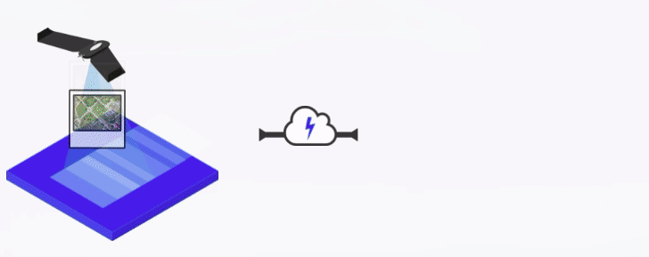
FOSS4U:
Free and Open Source for Uncrewed Aerial Systems
Stephen Mather, Executive Director
FOSS4G Asia
2022 November 27

Slide 2
Agenda
Background
Hands-On: Start Processing
Outputs
Using ODM
Learning Resources
Hands-On: Exercises

Slide 3
Background

Slide 4

About Me
Stephen (Steve) Mather
OpenDroneMap Ecosystem co-founder (with Piero Toffanin)
Specialize in large-scale elevation model creation from photogrammetry
Writing:
  Co-Author of the PostGIS Cookbook
  Blog at https://smathermather.com
Certified Remote Pilot (US FAA Part 107)

Slide 5
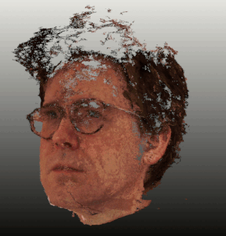
About Me
Stephen Mather
OpenDroneMap Ecosystem co-founder (with Piero Toffanin)
Specialize in large-scale elevation model creation from photogrammetry
Writing:
  Co-Author of the PostGIS Cookbook
  Blog at https://smathermather.com
Certified Remote Pilot (US FAA Part 107)

Slide 6
What is ODM?
Free and open-source toolkit for photogrammetry
from UAS imagery and other camera data
Georeferenced 2D and 3D outputs
  Orthophoto, DSM, DTM
  Point Cloud, Textured Mesh
Used globally by 10s of thousands of users across sectors private, public, and charitable/NGO sectors
Begun in 2014, significant improvements 2018-2021
  Output Quality
  Features
  Usability
GIF via WebODM.net

Slide 7
Why Open Source?
Accessible to orgs and programs with limited budgets
  Close source solutions can be as much as $300+/mo -OR- ~$5000 one-time
  ODM is $0* (free forever)
But equally more important:
Control over your toolchain (change if you want)
Shoulders of giants: many contributors, collective wisdom
Core software is a public goods
Transparency leads to greater
  Quality
  Security
*You can pay for certain parts, but not required.

Slide 8
ODM History
End of 2013 - Began as a joke on Geohipster
End of 2014 - Funded, organized FOSS project with multiple contributors
  Announced at State of the Map US 2014
  Incubated quietly at FOSS4G Korea
  Formal release, FOSS4G Portland

Slide 9
ODM Goals
Humanitarian
Ecology, conservation
Research
Data for the public good

Slide 10
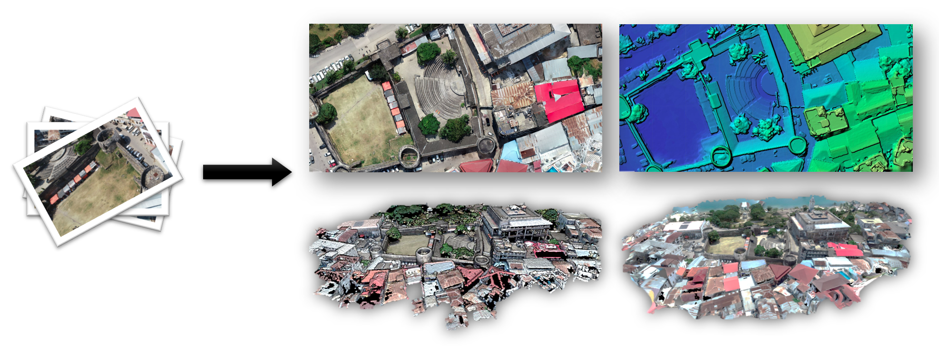
What is ODM?
Photogrammetry tool for general existing conditions datasets
  Orthophoto
  Elevation Models
  LiDAR-like point clouds
Digital Twin Creator

Slide 11
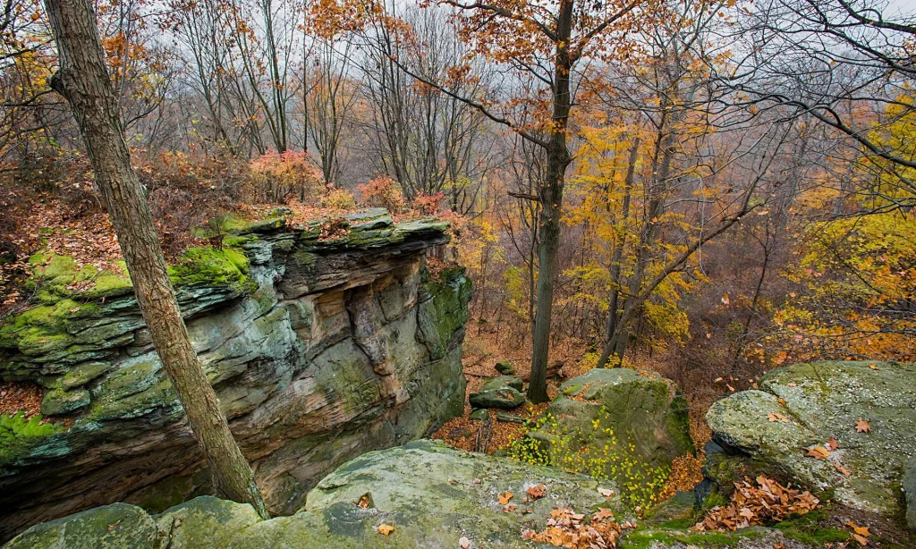
What is ODM?
Existing conditions
Hinkley Reservation (park), near Cleveland, Ohio, USA
Needed better terrain model than available from existing lidar datasets

Slide 12
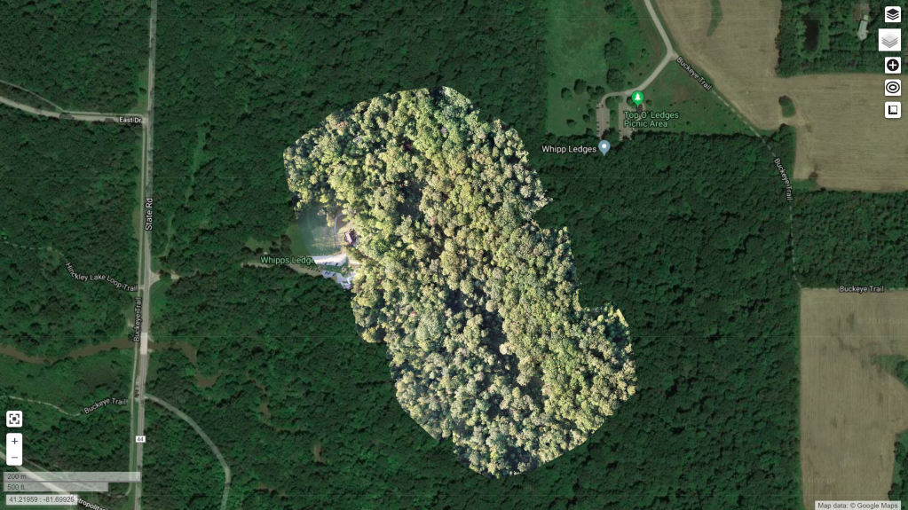
What is ODM?
Existing conditions
Hinkley Reservation (park), near Cleveland, Ohio, USA
Needed better terrain model than available from existing lidar datasets

Slide 13
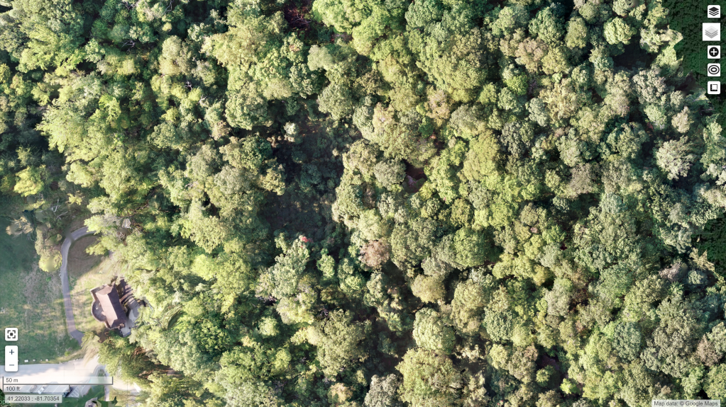
What is ODM?
Existing conditions
Hinkley Reservation (park), near Cleveland, Ohio, USA
Needed better terrain model than available from existing lidar datasets

Slide 14
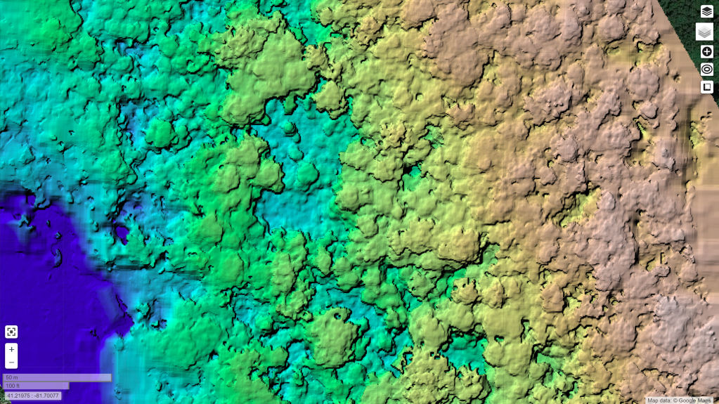

Slide 15
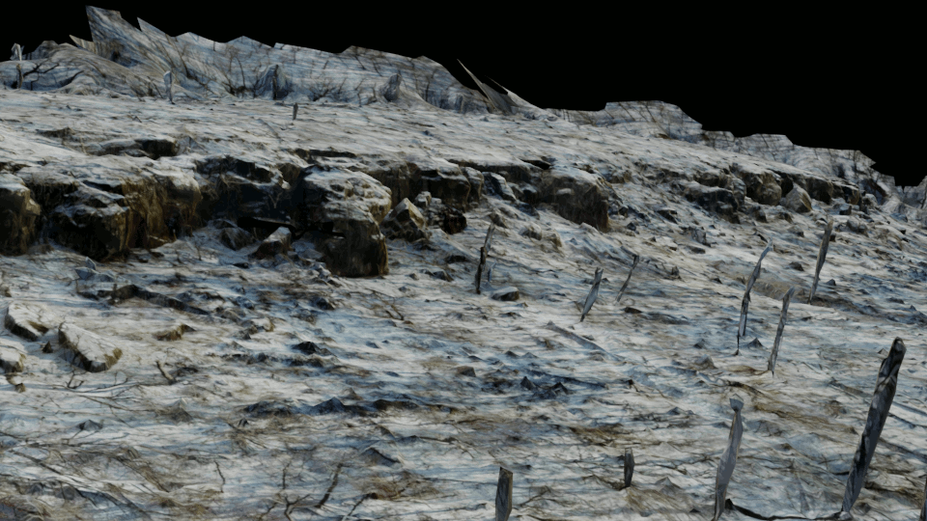
What is ODM?
Existing conditions
Hinkley Reservation (park), near Cleveland, Ohio, USA
Needed better terrain model than available from existing lidar datasets

Slide 16

What is ODM?
Existing conditions
Hinkley Reservation (park), near Cleveland, Ohio, USA
Needed better terrain model than available from existing lidar datasets

Slide 17
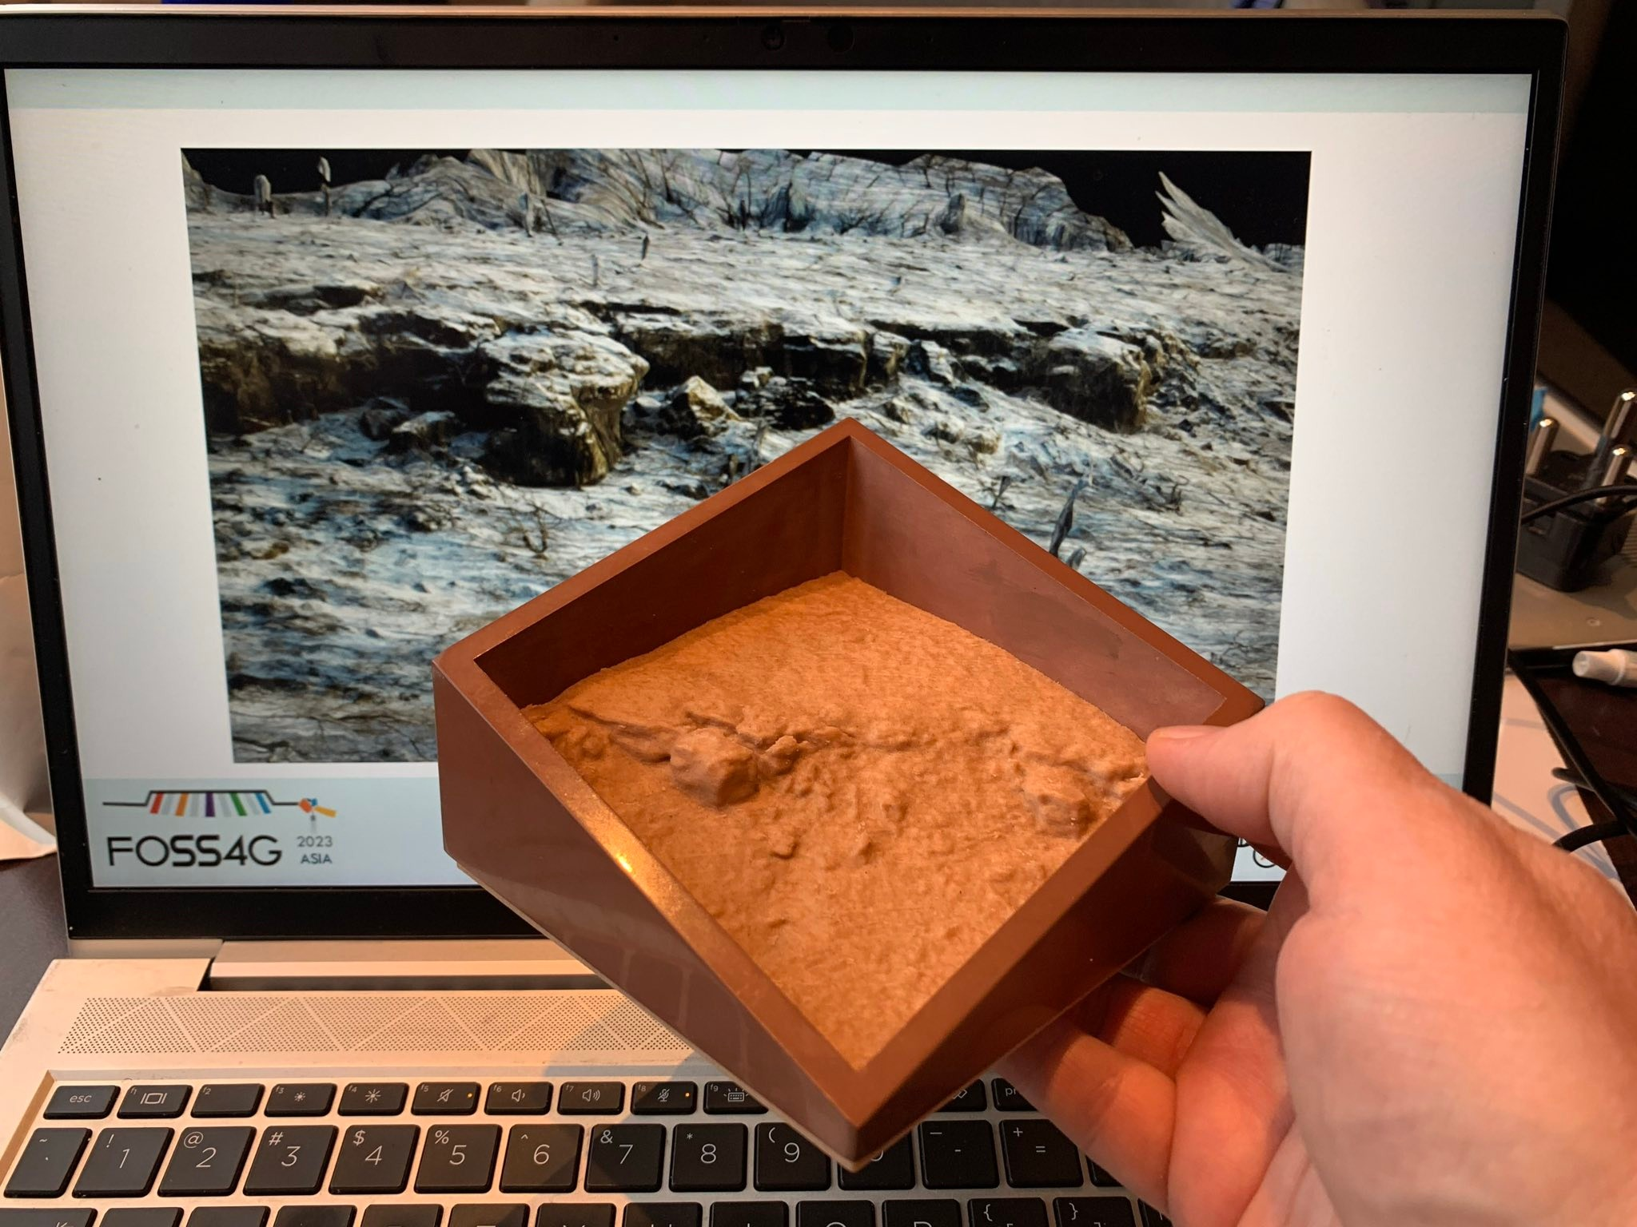
What is ODM?
Existing conditions

Slide 18
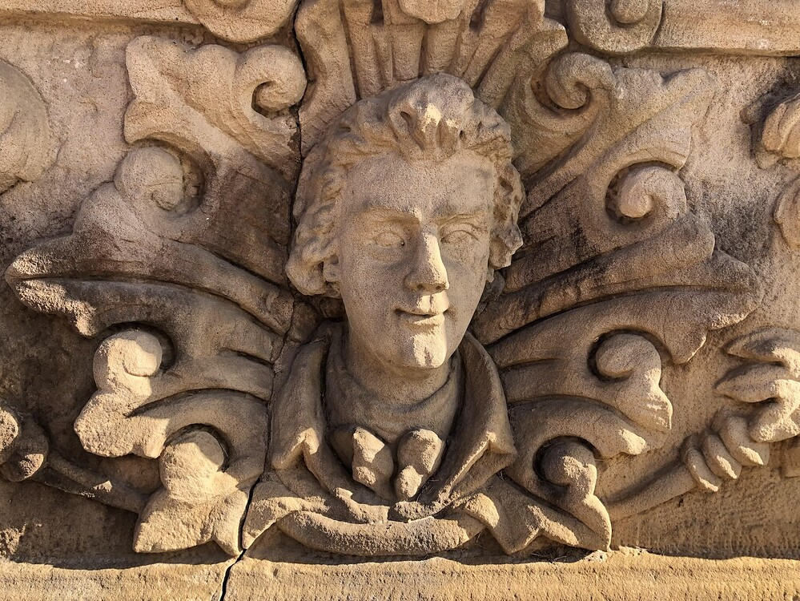
What is ODM?
Digital twins
Building fascade, Oberlin, Ohio

Slide 19
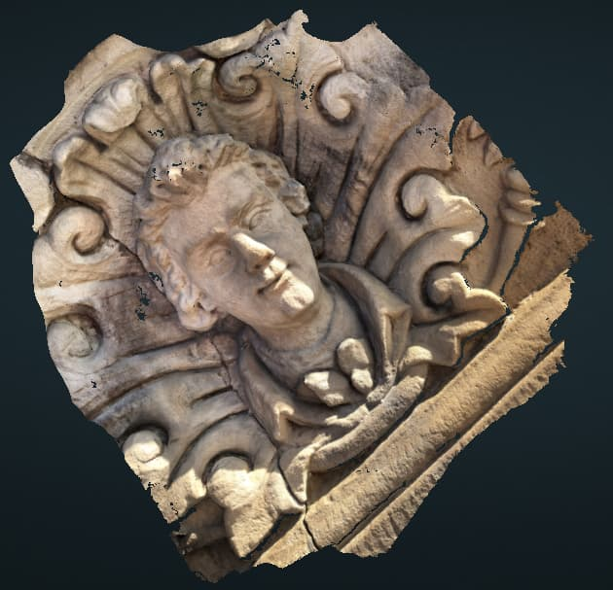
What is ODM?
Digital twins
Building fascade, Oberlin, Ohio

Slide 20
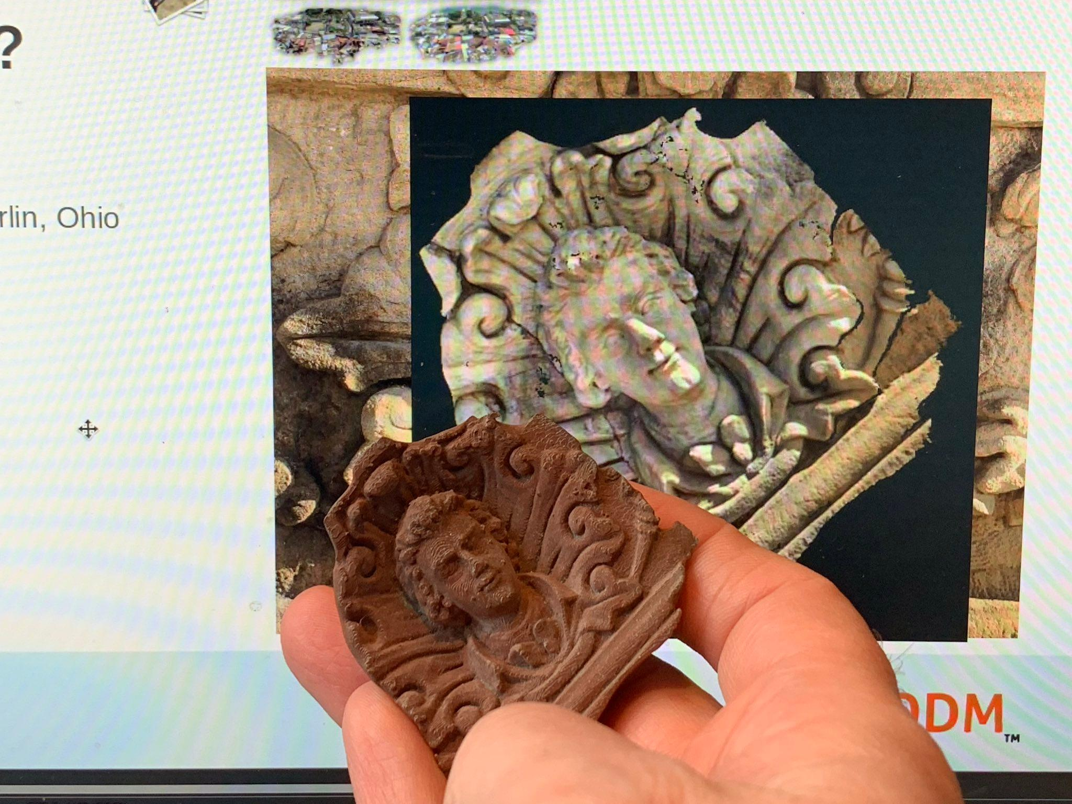
What is ODM?
Digital twins
Building fascade, Oberlin, Ohio

Slide 21
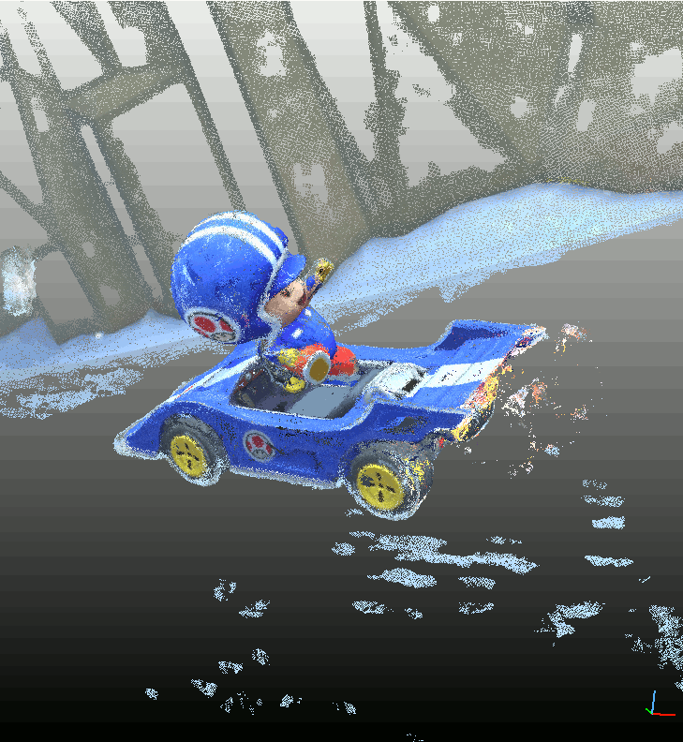
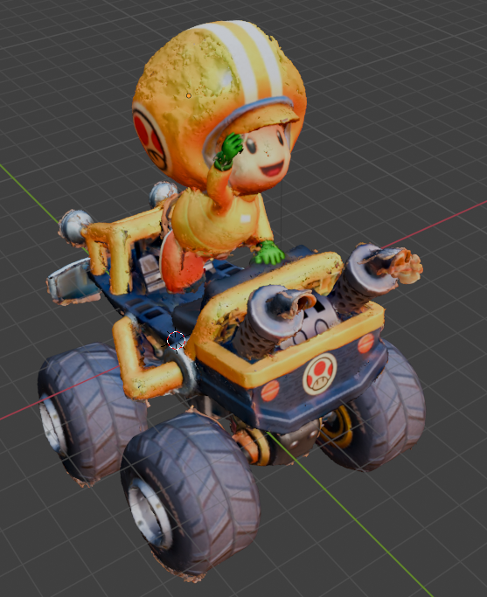
What is ODM?
Digital twins
Fictional digital twins

Slide 22
What is ODM?
Digital twins
Dr. Charles Ritzler
Cleveland Metroparks Zoo
Project Goals: Test new method, using 3D photogrammetry, to quantify usable space in both small and large primate habitats, and compare results to that of Browning and Maple (2019)

Slide 23

What is ODM?
Digital twins
Dr. Charles Ritzler
Cleveland Metroparks Zoo
Project Goals: Test new method, using 3D photogrammetry, to quantify usable space in both small and large primate habitats, and compare results to that of Browning and Maple (2019)

Slide 24
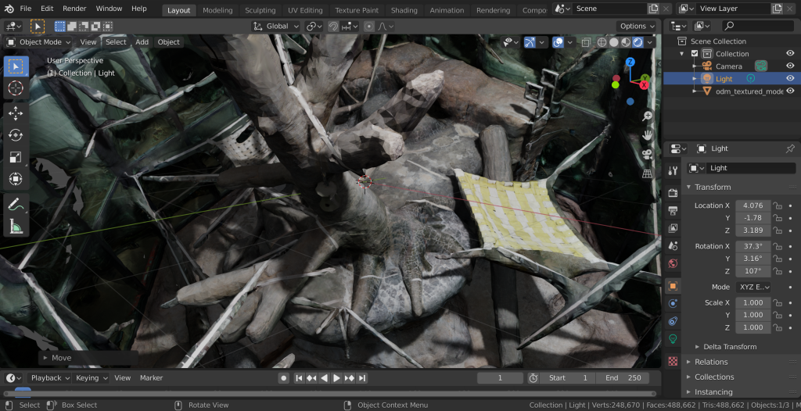
What is ODM?
Digital twins
Dr. Charles Ritzler
Cleveland Metroparks Zoo
Project Goals: Test new method, using 3D photogrammetry, to quantify usable space in both small and large primate habitats, and compare results to that of Browning and Maple (2019)

Slide 25
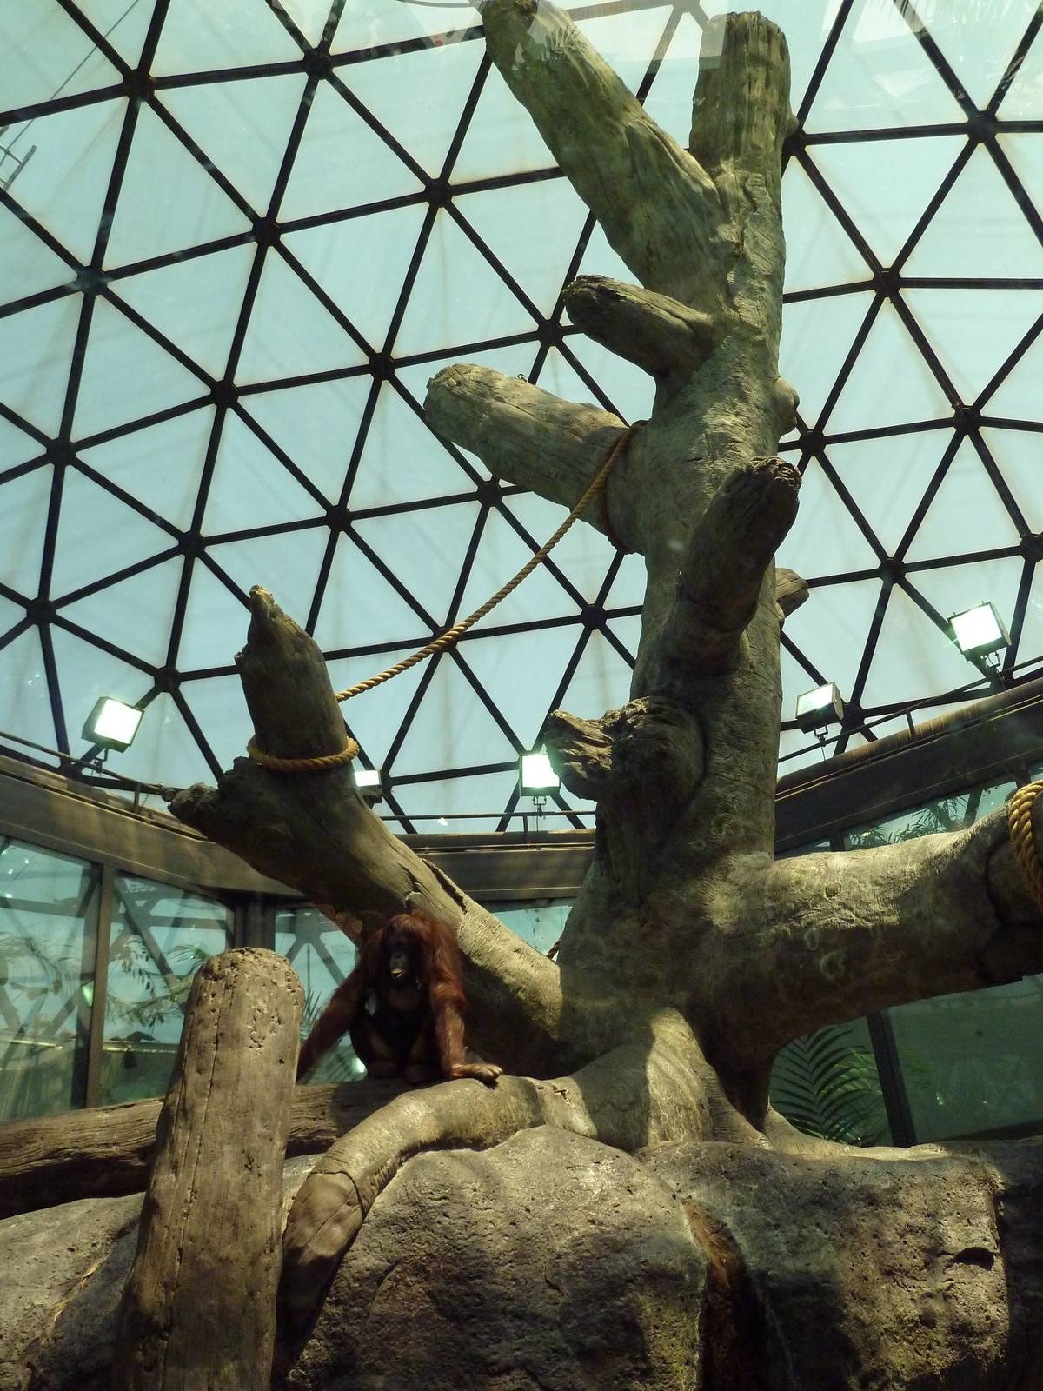
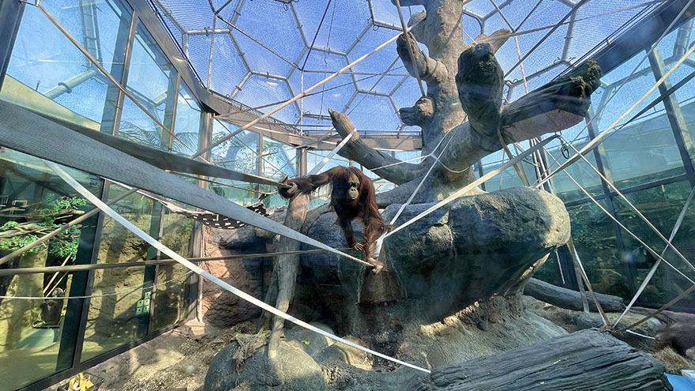
What is ODM?
Digital twins
Cleveland Metroparks Zoo
Project Goals: Test new method, using 3D photogrammetry, to quantify usable space in both small and large primate habitats, and compare results to that of Browning and Maple (2019)

Slide 26
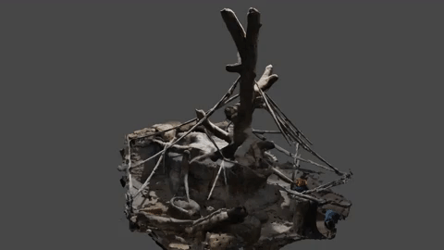
What is ODM?
June 2020: Pre-fire hose addition
2755 m²
Digital twins
Cleveland Metroparks Zoo
Project Goals: Test new method, using 3D photogrammetry, to quantify usable space in both small and large primate habitats, and compare results to that of Browning and Maple (2019)

Slide 27
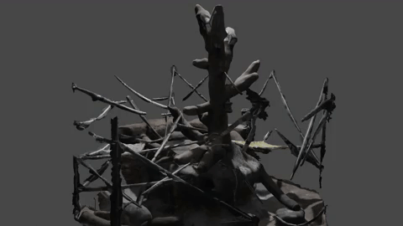
What is ODM?
January 2021: Post-fire hose addition
2824 m2
Digital twins
Cleveland Metroparks Zoo
Project Goals: Test new method, using 3D photogrammetry, to quantify usable space in both small and large primate habitats, and compare results to that of Browning and Maple (2019)

Slide 28
Hands-On: Part A
Start Processing

Slide 29
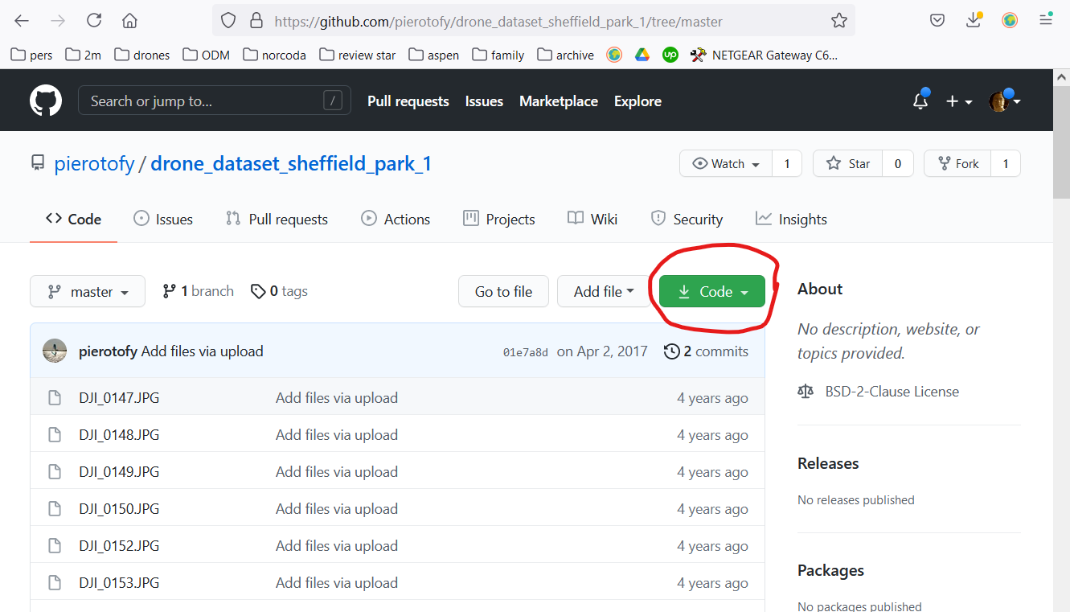
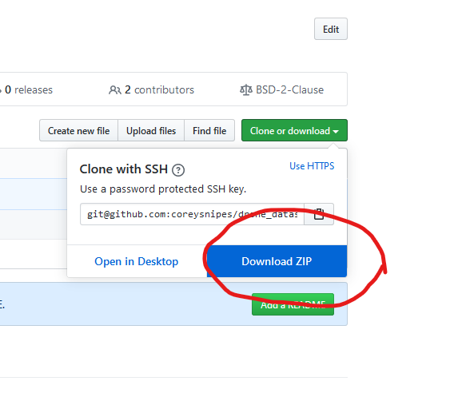
Download Sample Data
https://github.com/pierotofy/drone_dataset_sheffield_park_1/tree/master
https://tinyurl.com/sheffield-bb

Slide 30
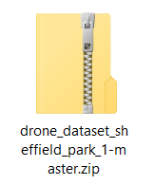
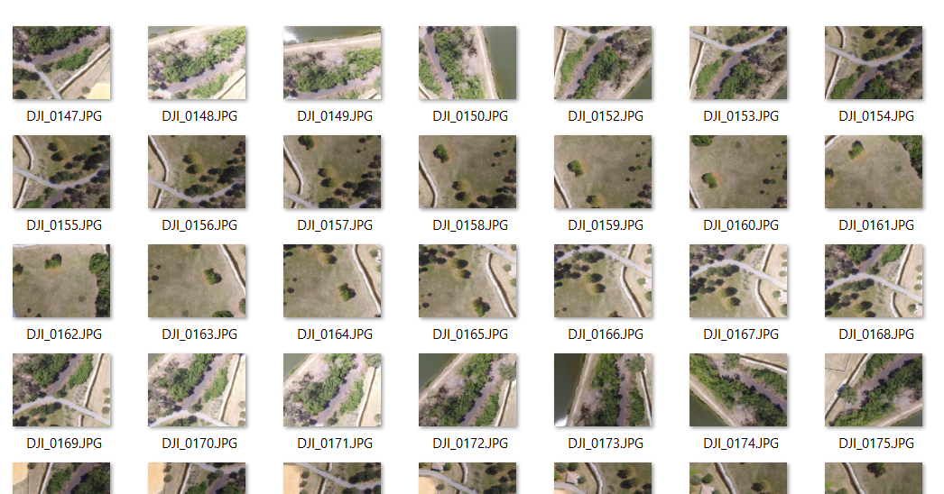
Unzip Files

Slide 31
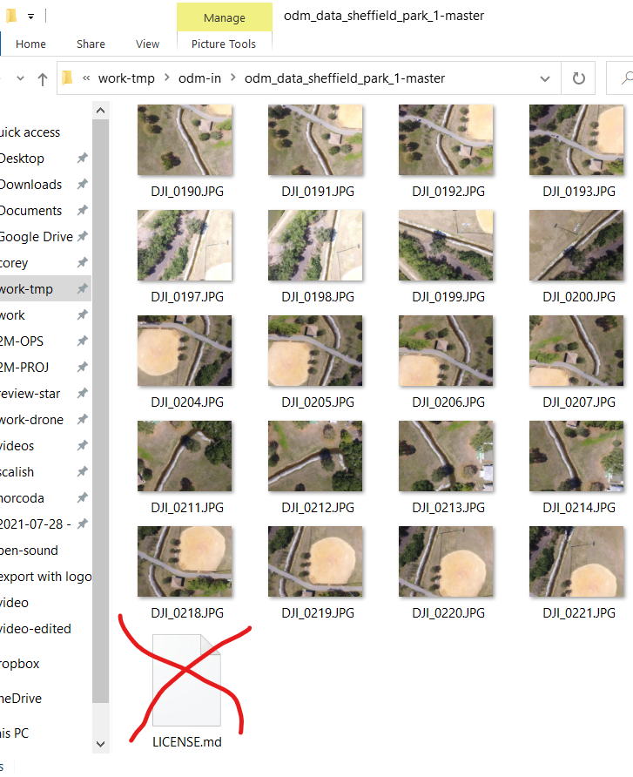
Remove LICENSE.md file

Slide 32
Open crankyserver.com
Point your browser to:
  https://crankyserver.com
  Username:
    FOSS4G_Asia
  Password:
    FOSS4G_Asia_2023_Seoul+Geo+BBQ+Soju

Slide 33
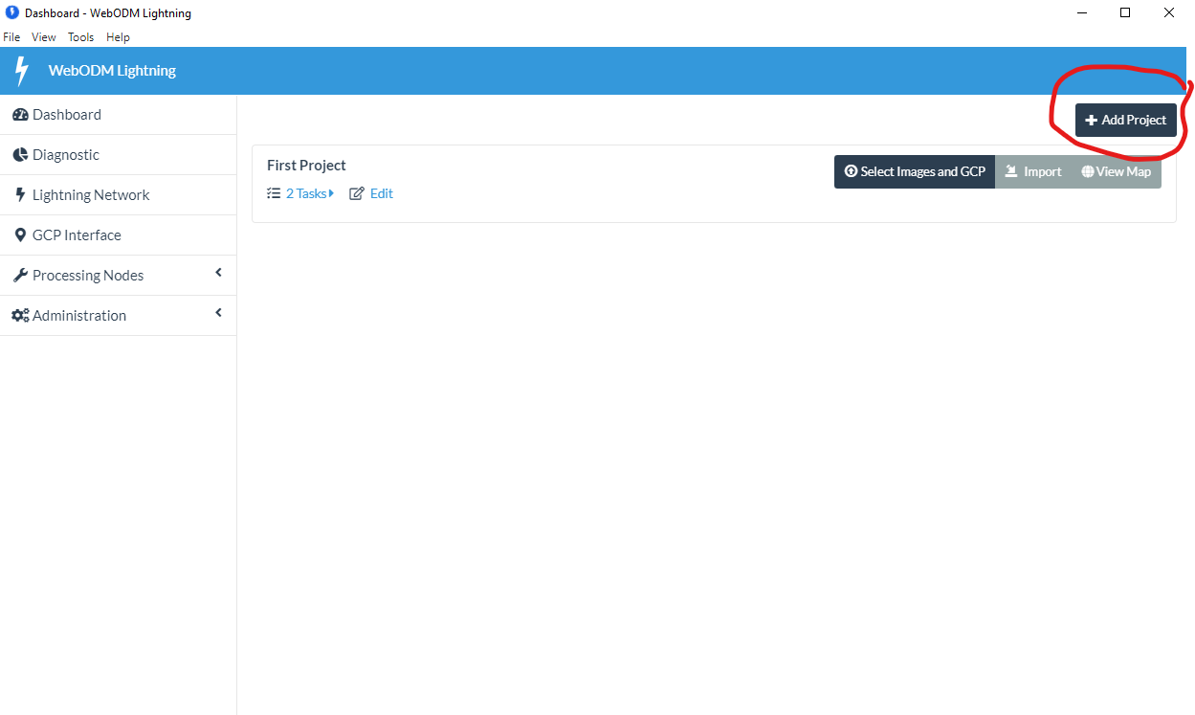
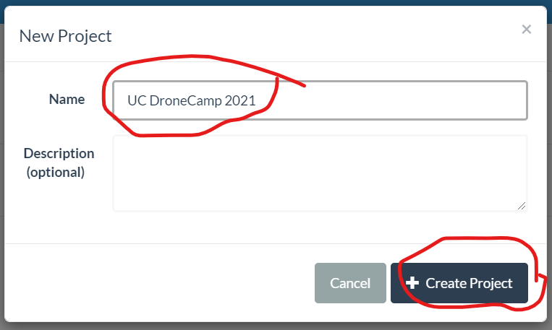
Open crankyserver.com
Your Surname Here

Slide 34
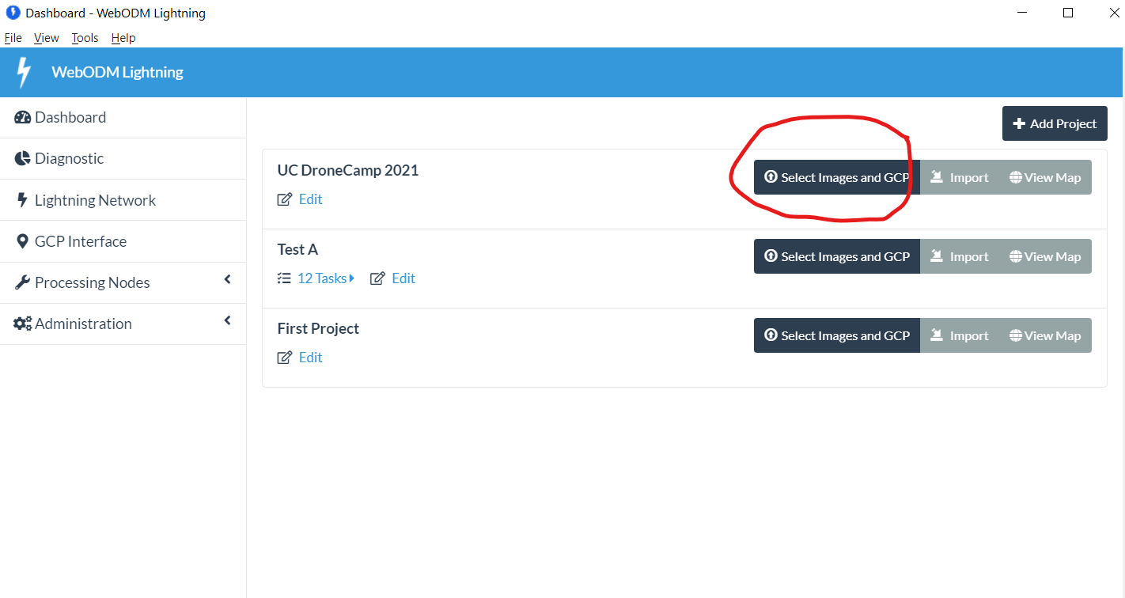
Add Images

Slide 35
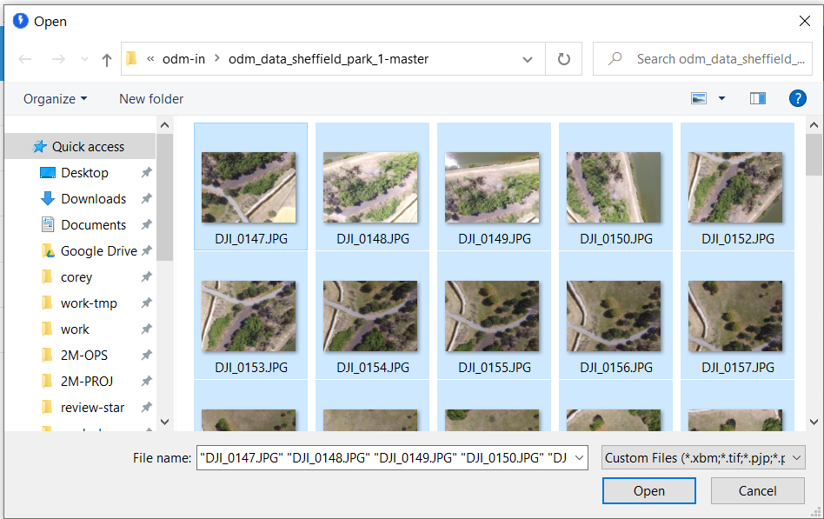
Add Images
(No Ground Control Points, today)

Slide 36
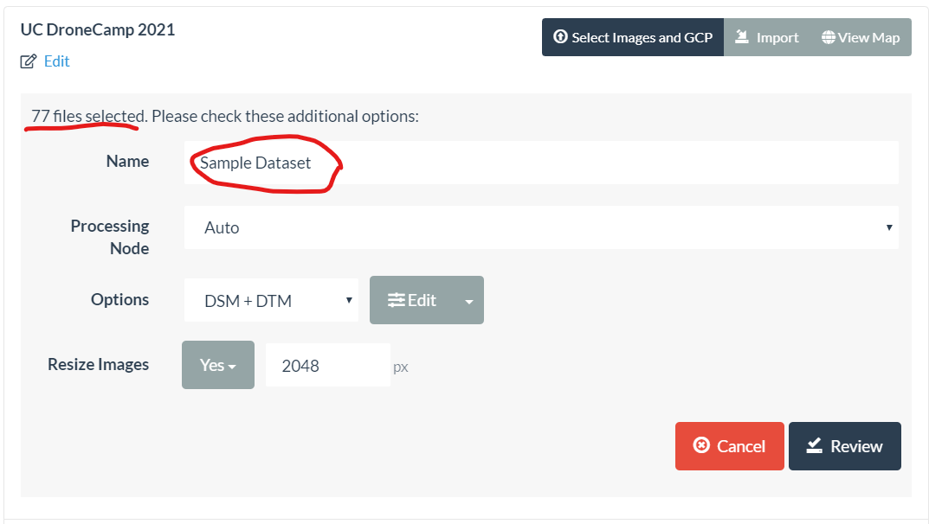
Set Configuration

Slide 37
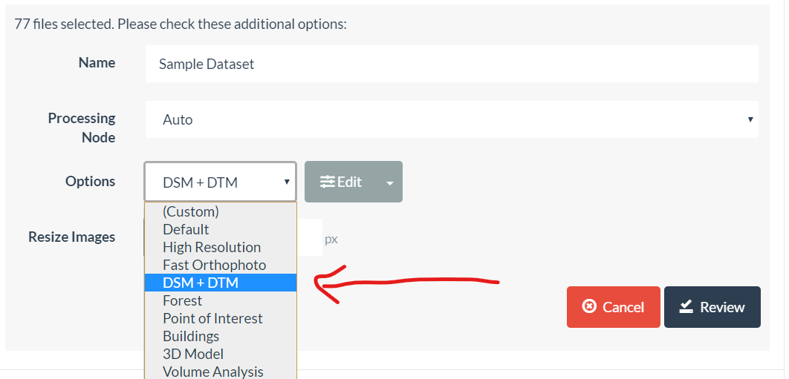
Set Configuration

Slide 38
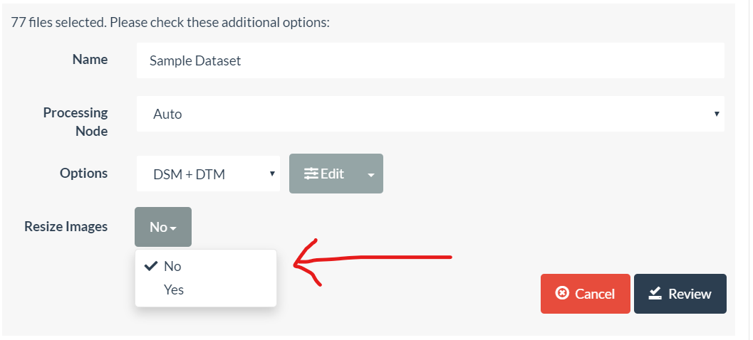
Set Configuration

Slide 39
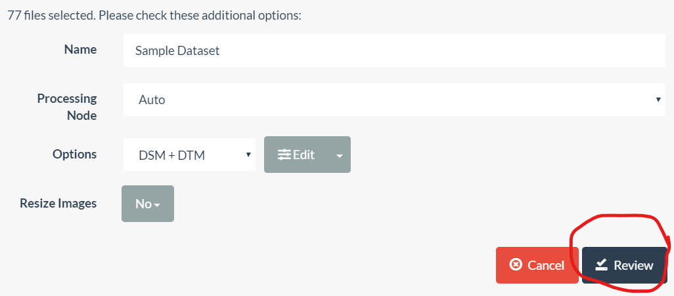
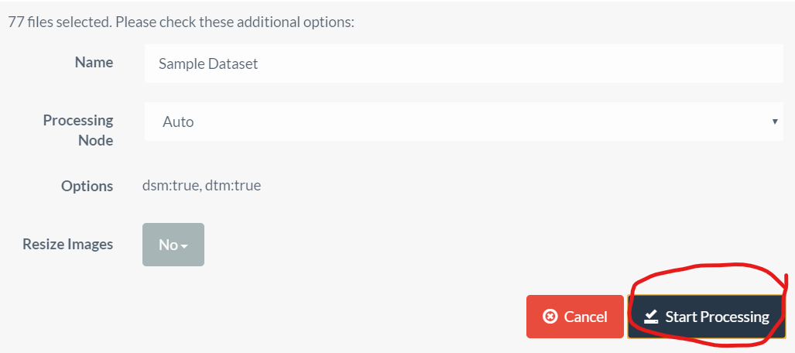
Start Processing

Slide 40
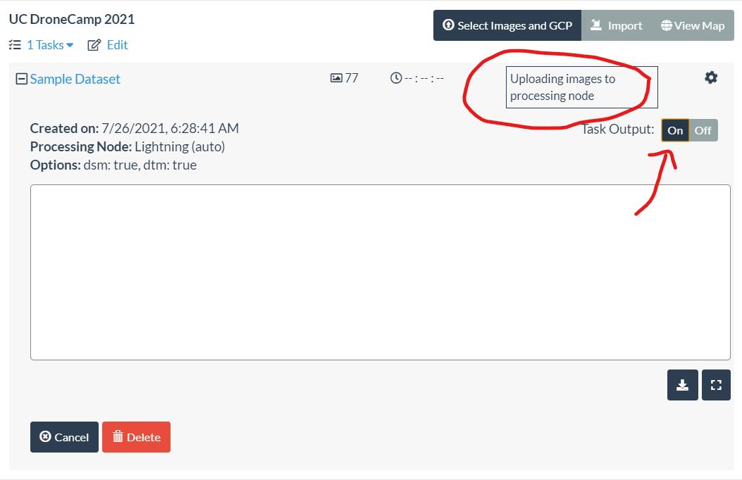
Processing Status

Slide 41
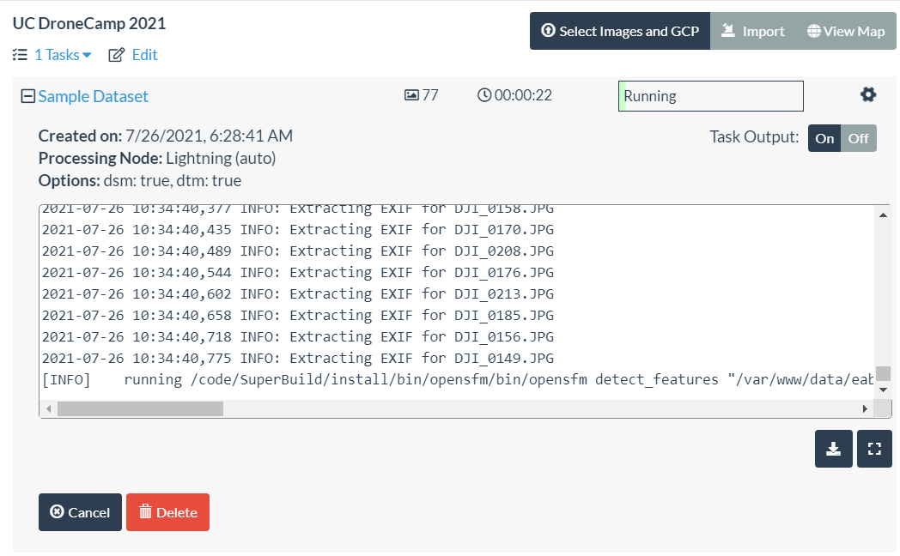
Running

Slide 42
Outputs

Slide 43
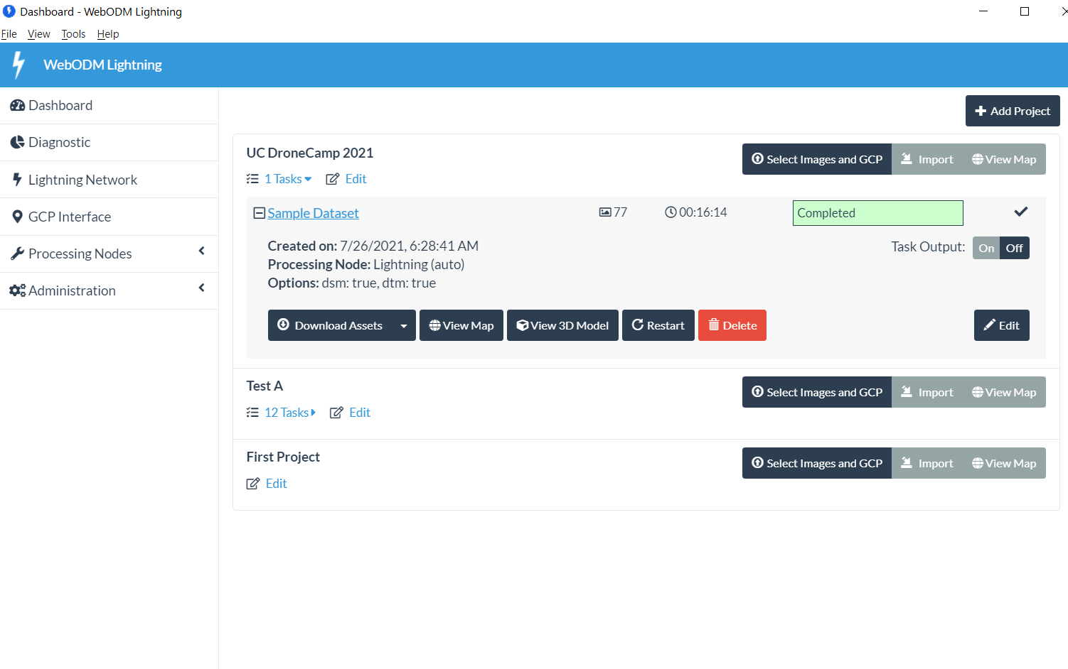
2D Ortho

Slide 44
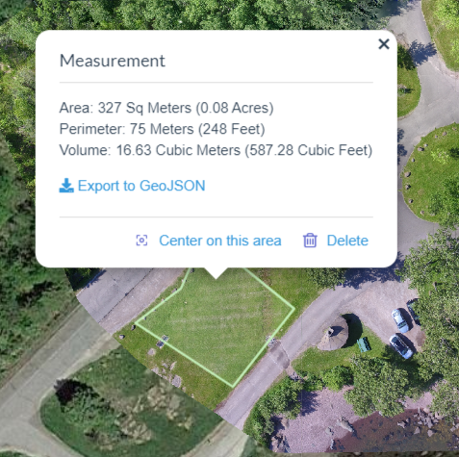
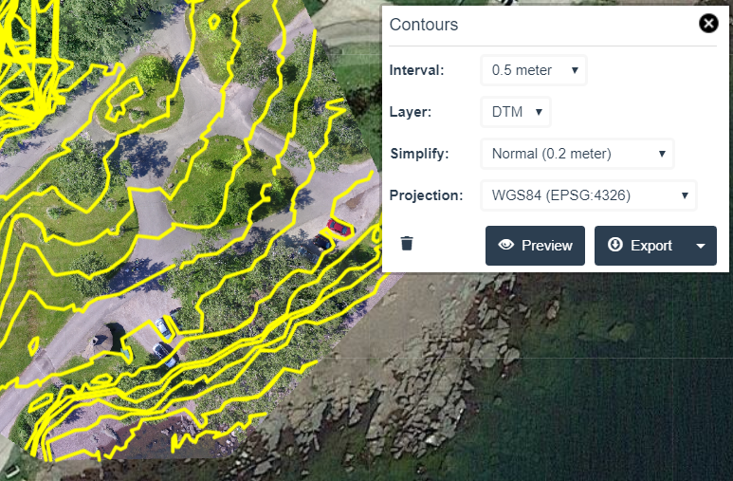
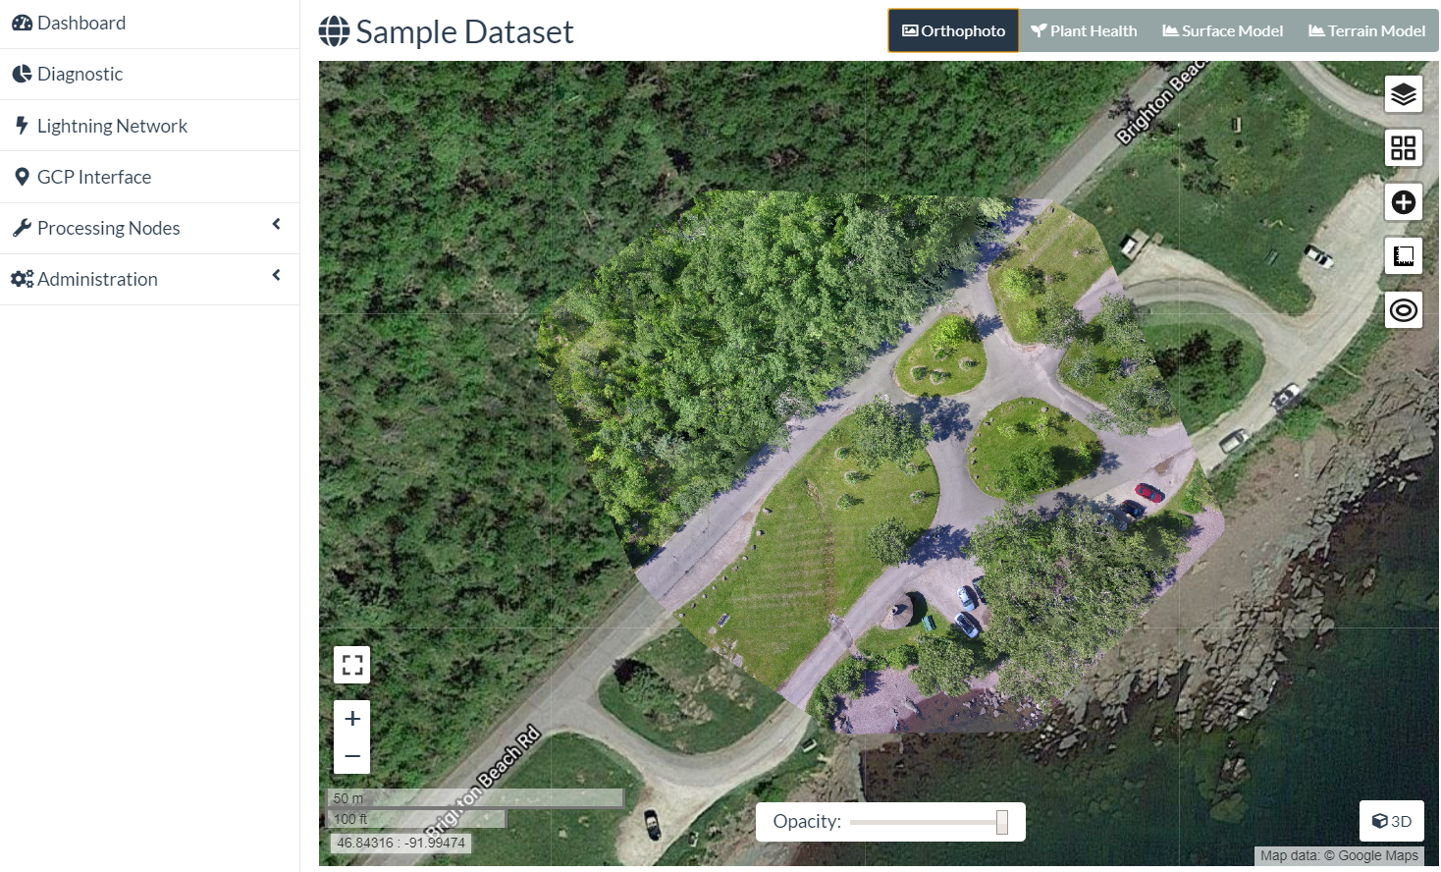
2D Orthophoto
Overlay on Google Map, OpenStreetMap, etc
Measurements (linear, area, volume)
Contour Lines
→ QGIS/ArcGIS
→ Object detection/counting via
FieldMapR, rastervision.io

Slide 45
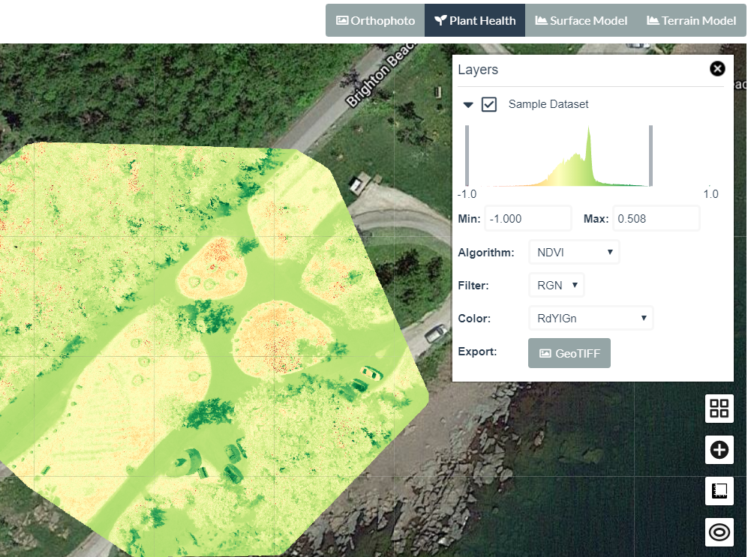
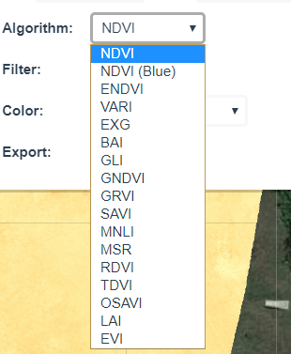
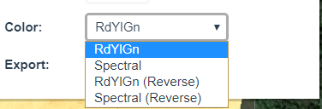
Plant Health Index
Images from multi-spectral cameras (Micasense, Sentera, etc)
Wavelengths beyond visible spectrum
Algorithms:
NDVI, RDVI, GLI, SAVI, more

Slide 46
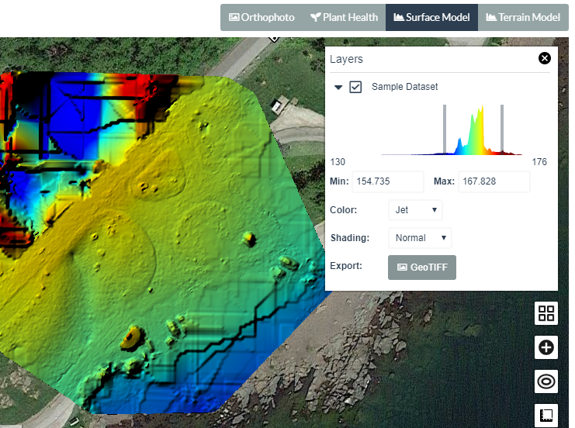
2D Surface Model (DSM)
Highlights surface altitude
Adjustable color ramps
Export GeoTIFF

Slide 47
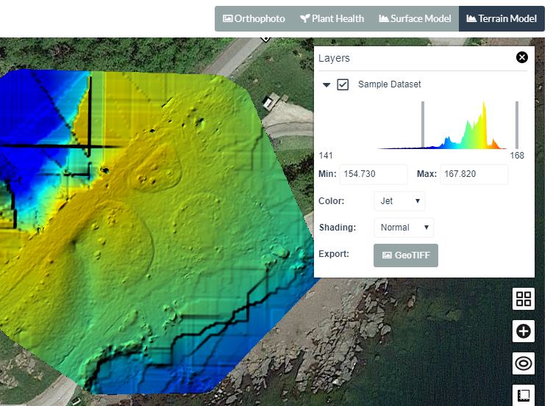
2D Terrain Model (DTM)
“The DSM without the trees and buildings”
Uses point classification to remove objects from the surface model
Ground (terrain) profile
Contour lines

Slide 48
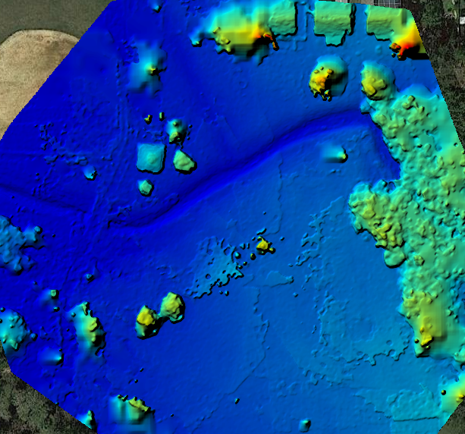
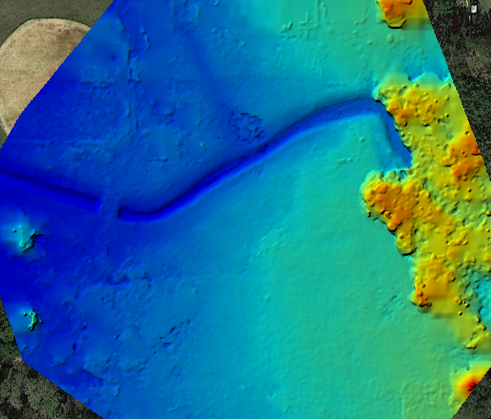
2D Terrain Model (DTM)
DSM
DTM
Images: opendronemap.org

Slide 49
3D Model

Slide 50
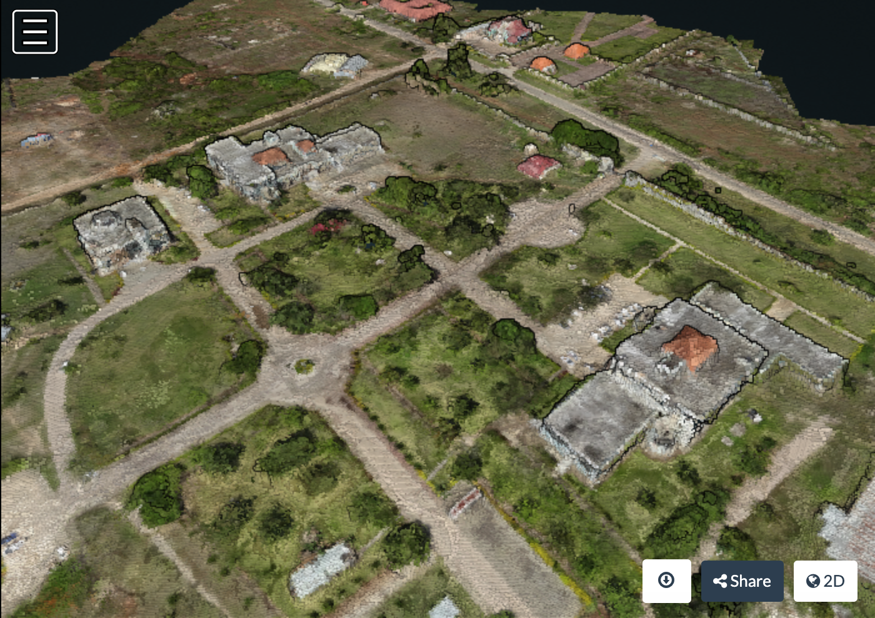
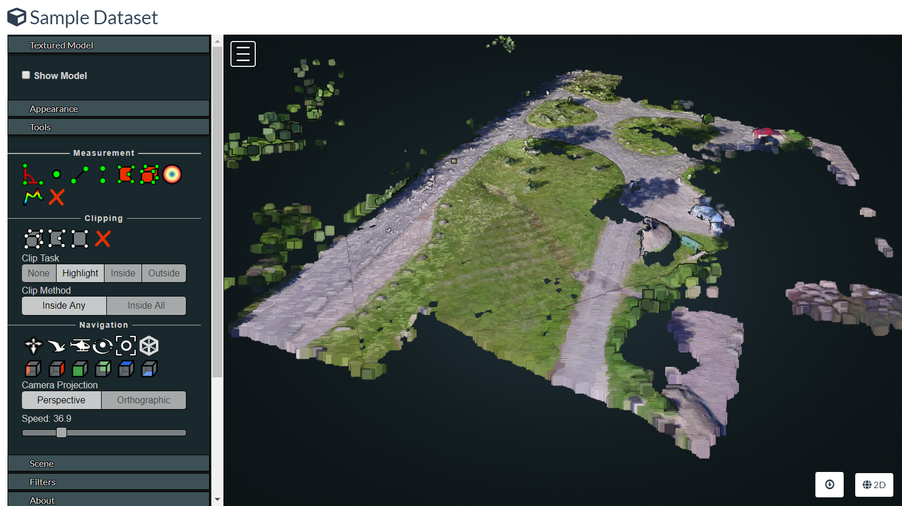
Point Cloud
Individual points
X, Y, Z
Measurements
→ CloudCompare
for analysis
Image: opendronemap.org

Slide 51
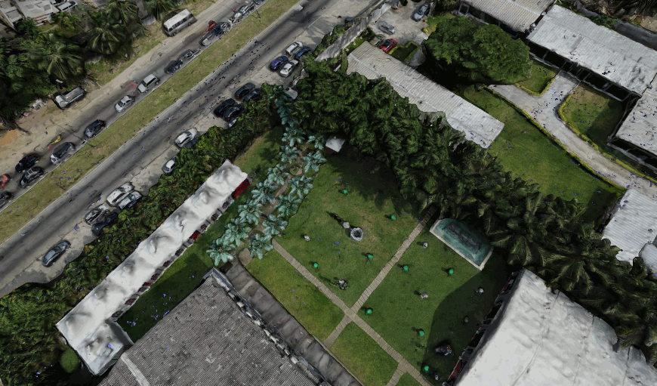
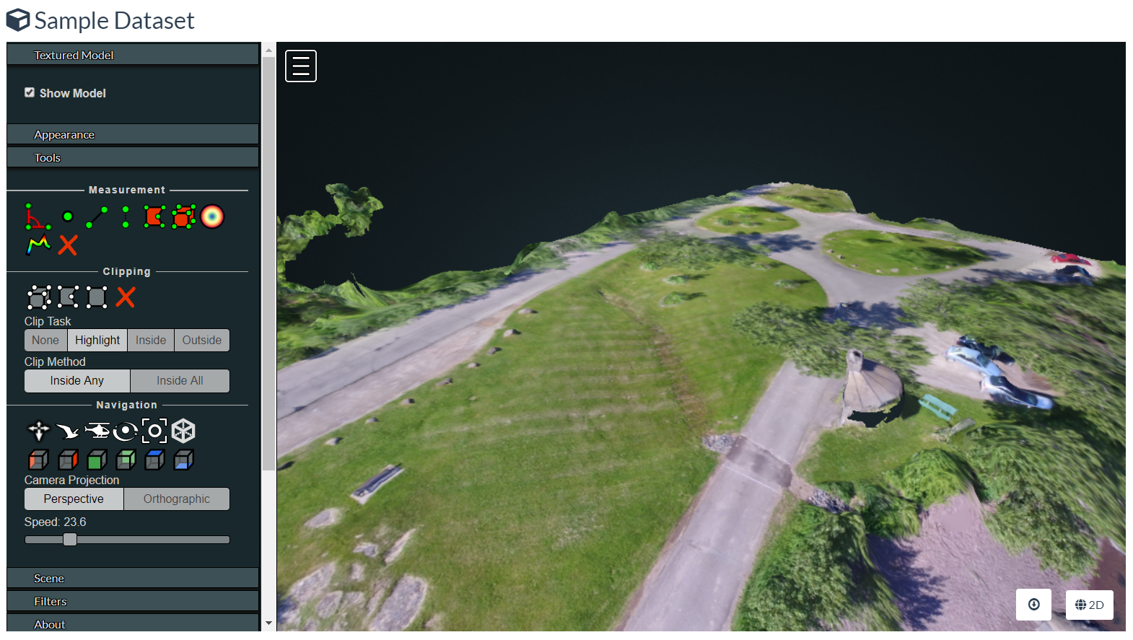
Textured Model
Identify surface
triangles
Point Cloud ->
Surface Mesh
→ Sketchfab, et al
for sharing
→ CAD, Blender
→ 3D print
Image: opendronemap.org

Slide 52
3D Measurements
Linear
Area
Angle
Height
Height Profile
Volume

Slide 53
Download
Orthophoto (GeoTIFF)
Terrain Model / DTM (GeoTIFF)
Surface Model / DSM (GeoTIFF)
3D Point Cloud (.laz)
3D Textured Model (.obj)
Camera Parameters
Quality Report
Everything (all.zip)

Slide 54
Using ODM

Slide 55
Supported Systems
Windows 10 (Docker, or native)
Ubuntu Linux (Docker, or native)
MacOS
16+ GB RAM (more is better)
50+ GB Disk (more is better)

Slide 56

Ways to Use ODM
WebODM – most common
  Manual (free)
  or, Installer ($)
WebODM Lightning – easiest
  Process on Lightning servers ($)
Command Line ODM
API (NodeODM)
LiveODM (USB or DVD) ($)
Portable OpenStreetMap (POSM)
Image: opendronemap.org

Slide 57
Common Problems
Many paths to get started with ODM.
  Where to start?
  All require some work
Jumping in with a large dataset (start small!)
System resources
  Machine spec
  Docker allocations
Processing is hung (or is it?)
Processing failed, but not sure why
Output quality vs. expectation

Slide 58

Large Datasets
Split/Merge
ClusterODM
Image: opendronemap.org

Slide 59

Output Quality
Comparable to commercial products
Commercial output quality can be better with:
  Default settings
  Poor flight coverage
ODM produces comparable quality with:
  Sometimes with default settings
  Often with tuned settings
  Good flight coverage (overlap, multiple POV)
https://opendronemap.github.io/UAVArena/

Slide 60



Object Detection, Counting, Analysis
Documented workflows using external tools
(not within ODM)
FIELDimageR
  “A Tool to Analyze Orthomosaic Images From Agricultural Field Trials in R”
  https://www.opendronemap.org/fieldimager/
rastervision.io

Slide 61
Summary

Slide 62
Output Summary
2D outputs
  Orthophoto
  Terrain/Surface Models
  Plant Health
3D outputs
  Point cloud
  Textured mesh

Slide 63
ODM Summary
ODM is Open Source, with benefits in
  Cost
  Control
  Community
  Infrastructure
Output quality is comp

Slide 64
Learning More

Slide 65
UAV Arena
Compare Outputs
  ODM
  Pix4D
  DroneDeploy
  Agisoft Metashape
  DroneMapper
https://opendronemap.github.io/UAVArena/

Slide 66

ODM Docs
https://docs.opendronemap.org

Slide 67

ODM Book
https://odmbook.com
~$30
Image: odmbook.com

Slide 68


Community Forum
https://community.opendronemap.org

Slide 69
Hands-On: Part B
Working with Outputs

Slide 70
WebODM vs. WebODM Lightning
WebODM
  Install for free
  Process locally for free
WebODM Lightning
  Commercial service
  Install for free
  Process in the cloud ($)

Slide 71

Still Running?

Slide 72

Finished
Today, Speed > Quality

Slide 73
Exercises – 2D Orthophoto

Slide 74

#1 – Orthophoto - Navigate
Click+hold = move map
Scroll wheel = zoom in/out
Map controls +/- = zoom
Map control square = full screen
Top buttons:
  Ortho
  Plant Health
  Surface Model
  Terrain Model

Slide 75

#2 – Orthophoto - Measure
Click ruler (5th on right)
Create new measurement
Click 2 points on map
Click “Finish measurement”
View calculations in white balloon
Close balloon with “x”
Click ruler again, new measurement
Click 4 points on map to make a box, click “Finish”
View calculations
Click “Delete” to remove it

Slide 76

#3 – Plant Health
2nd Top Button: Plant Health
Note color differences in different grassy areas
Click top right “layers” icon
View “Algorithm” options
View “Color” options
Drag min/max bars
Export GeoTIFF

Slide 77

#4 – Surface Model (DSM)
3rd Top Button: Surface Model
Wait for calc/load
Note color varies by altitude
Click top right “layers” icon
View “Color” options
Drag min/max bars
Wait for refresh
Export GeoTIFF

Slide 78

#5 – Terrain Model (DTM)
4th Top Button: Terrain Model
Wait for calc/load
Note color varies by altitude
Click top right “layers” icon
View “Color” options
Drag min/max bars
Wait for refresh
Export GeoTIFF

Slide 79
Exercises – 3D Model

Slide 80

#6 – 3D Model - Navigate
Left click+drag = rotate model
Right click+drag = move model
Scroll wheel = zoom in/out
Top left (3 bars) button = collapse tools
Top left (map) button = show model location
Tools
  Measure
  Navigation
Appearance
Scene

Slide 81

#7 – 3D Model – Measure (Linear)
Adjust the model so you can see
Click 3rd Measurement tool (angled line)
LEFT click 2 points on the map
Now RIGHT click the last point to finish
View measured distance (m)
Click red “X” in measurement tools, to delete

Slide 82

#8 – 3D Model – Measure (Area)
Adjust the model so you can see
Click top right Measurement tool (red box)
LEFT click 4 points on the map
Now RIGHT click the last point to finish
View measured distances (white)
View measured area (green)

Slide 83

#9 – View Textured Model
Find “Textured Model” near the top of the tool menu
Click to expand, then click “Show Model”
Wait a few seconds
View how the scene becomes more detailed, holes are filled
Uncheck and check the box to turn off, and on
Move the model around to view other parts
Edges of model = lots of error
Interior of model = better precision

Slide 84

#10 – View Cameras
Find “Cameras” near the top of the tool menu
Click to expand, then click “Show Cameras”
Zoom out (scroll) until you see the blue squares floating above the scene
Note positions, angles of cameras
Click one camera to see the photo from that position

Slide 85
Exercises – Download

Slide 86

#11 – Download Specific Outputs

Slide 87





#12 – Download All

Slide 88
Contact Me
Stephen.Mather@opendronemap.org
This material is based on presentations by:
Corey Snipes – Two Mile Heavy Industries
Piero Toffanin - ODM, UAV4GEO
Screenshots and interface images by Corey Snipes
or Stephen Mather, unless otherwise n
https://opendronemap.org
https://github.com/opendronemap/presentations
Coupon for 80% off installer:
https://opendronemap.org/webodm/download/#installer
Then for coupon code, use the email address you used to register for this conference, but:
replace “@” with underscore “_” and dots with dashes “-”
e.g. Stephen.Mather@opendronemap.org would become
Stephen-Mather_opendronemap-org
Thank You!

